Slide 1

模糊数学理论在防灾社区评价中的应用
Application of Fuzzy Mathematic Theory in the Evaluation on Urban Disaster Mitigation
Song Bo
University of Science Technology Beijing, China
2014-2-14

Slide 2
Main Content
1 研究背景
Research Background
2 社区防灾实地调查分析
Site Investigation on Urban Disaster Mitigation
3 防灾社区评价体系与指标
Evaluation System and Target of Urban Disaster Mitigation
4 模糊数学理论在社区防灾评价中的应用
Application of Fuzzy Mathematic Theory in the Evaluation on Urban Disaster Mitigation
5 体系评价方法与数据库建设
System Evaluation Method and Database Construction on Urban Disaster Mitigation

Slide 3
1.研究背景
Research Background
（1）中国的地震与火山
Earthquakes and volcanoes in China
（2）经济发展与灾害现象
Economic development and disaster phenomenon
（3）灾害进化的新特点
New characteristics of disaster evolution
（4）减灾的有效措施
Effective mitigation measures
（5）面临的问题
Confronting problem
（6）主要的研究内容与研究意义
The main research contents and research significance

Slide 4
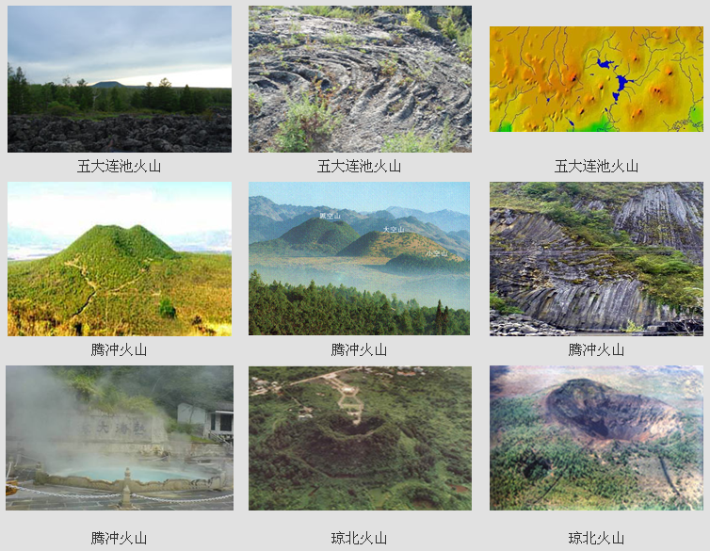
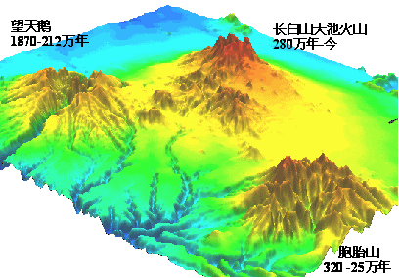
（1）中国的地震与火山
Earthquakes and Volcanoes in China
Volcano in China mainly include the Changbai mountain volcano (1668, 1702), Wudalianchi volcanoes (1720, 1721), Tengchong volcano (1609), North Volcanoes in Hainan Island (1883).
城市洪涝灾害
城市火灾

Slide 5
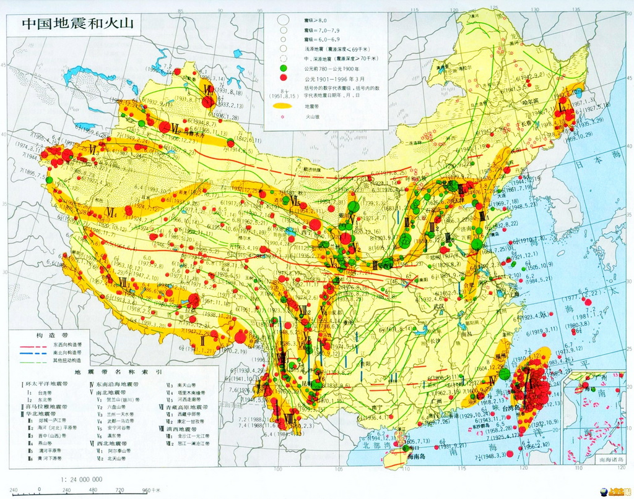
The Main Distribution of Volcanoes and Earthquakes in China

Slide 6
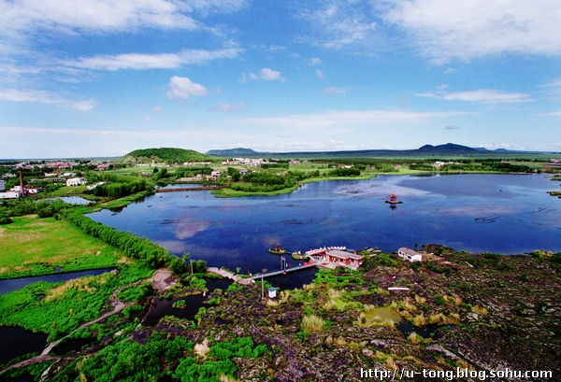
黑龙江五大连池山
Heilongjiang wudalianchi volcanoe

Slide 7
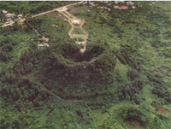
琼北火山
North Volcanoes in
Hainan Island

Slide 8
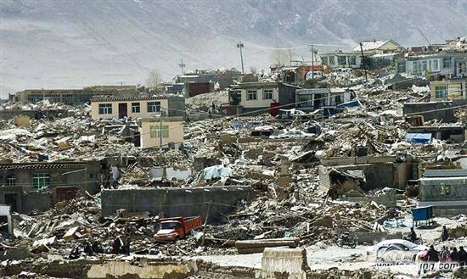
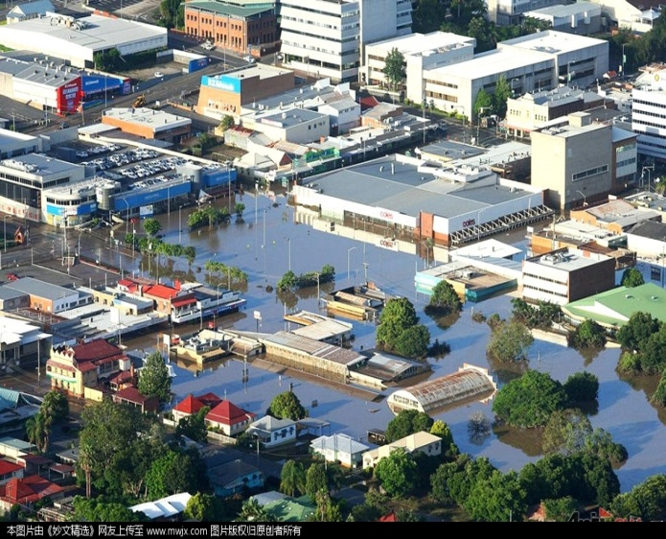
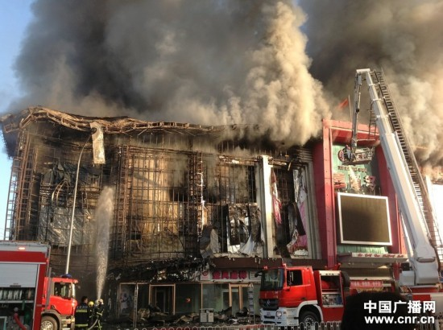
（2）经济的发展与灾害现象
Economic Development and Disaster Phenomenon
In recent years, the development of urban construction is not coordinated with the urban disaster prevention resources environment, rapid growth of cities presented with highly complex and changeable features for urban function spaces. Especially last several years, earthquake, flood, hurricane, lightning, dust, fog, fire and other extreme weather disasters have more and more influences on the cities. In the rapid construction of urban city, there are still a lot of blind spot existing in the field of disaster prevention construction, which make cities of China very fragile when facing disasters.
Earthquake
Flood
Fire

Slide 9
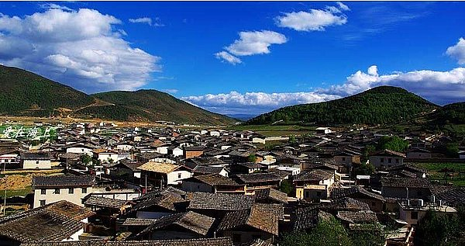
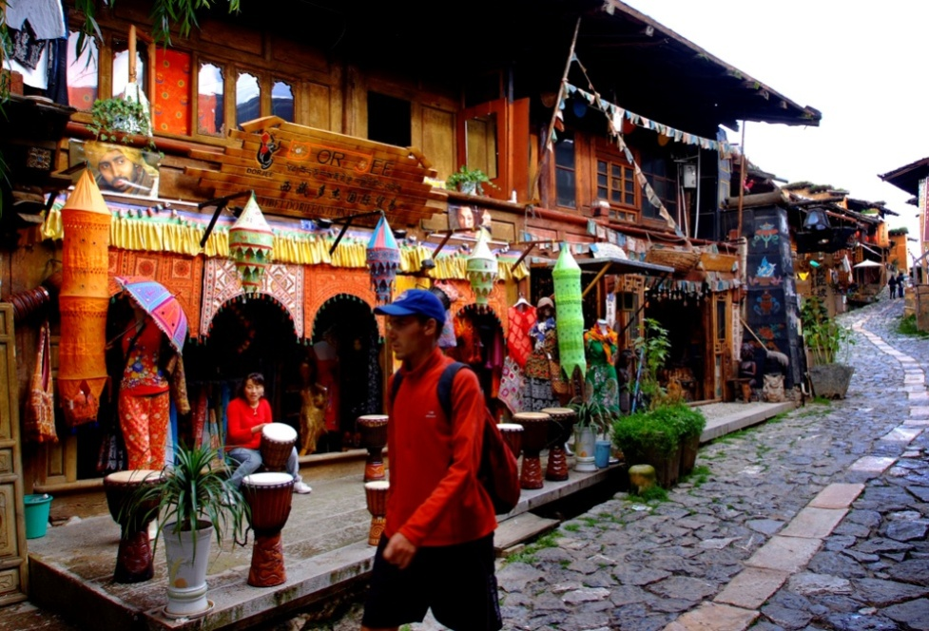

（a）古城的社区火灾
The Fire of Ancient City Community
☆The fire of ancient Duke Zong city.The ancient Duke Zong city located in Yunnan, which is an ancient city with a history of more than 1300 years, the urban structure is wood usually. As an important city in the the ancient tea horse road, there are better-preserved Tibetan dwellings here and attract millions of tourists from home and abroad to sightseeing every year.

Slide 10
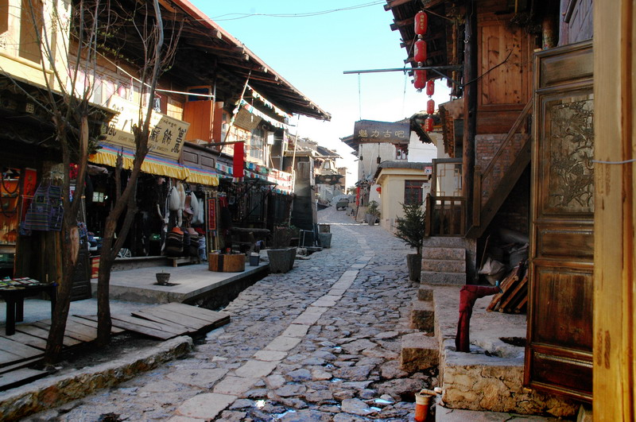
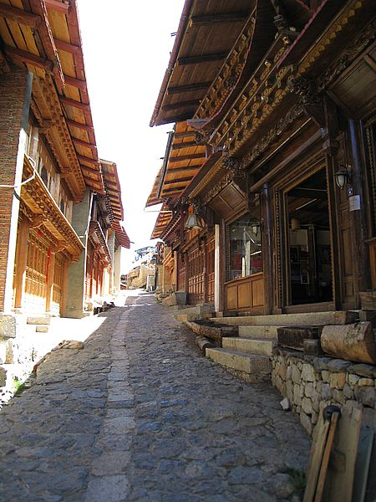
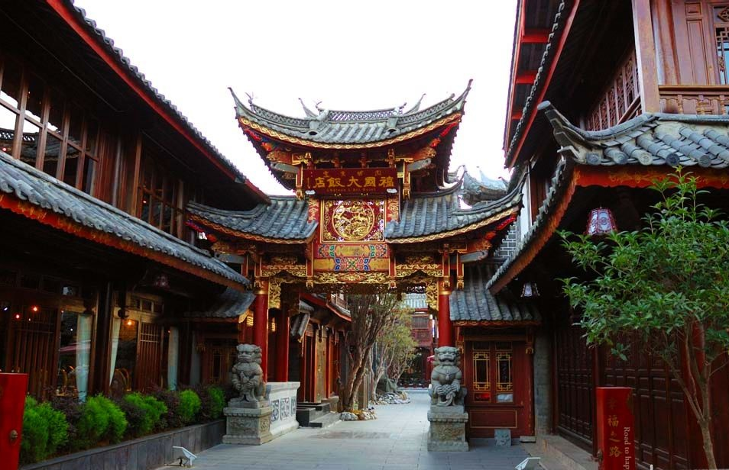
古城火灾前
Ancient City Community before the Fire

Slide 11
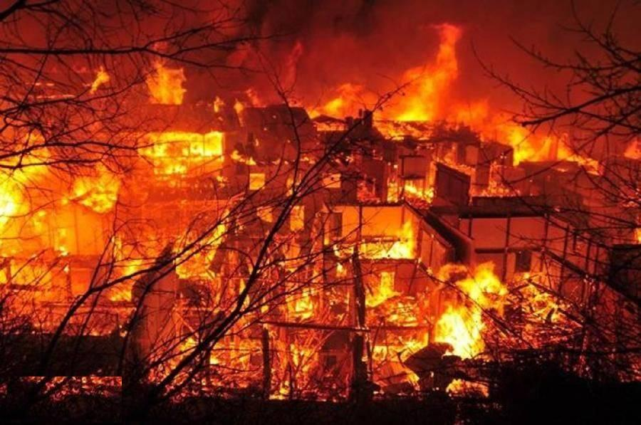
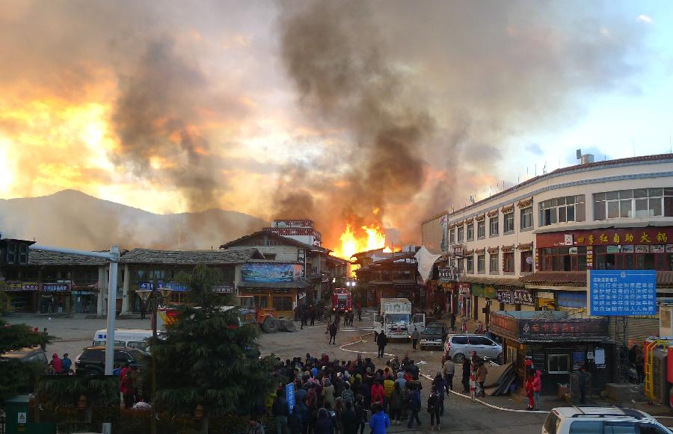
古城火灾
Ancient City Community in Fire
On January 11, 2014, Shangri-la Dukezong ancient city, suffering a terrible fire for more than10 hours, which make the city in ruins, among them, the building area of 59980m² are in a fire burning, direct property losses are 89 million yuan.
It has been identified that, the fire was caused due to the improper use of heaters inside the bedroom for an inn operator, it is a electrical fires.

Slide 12
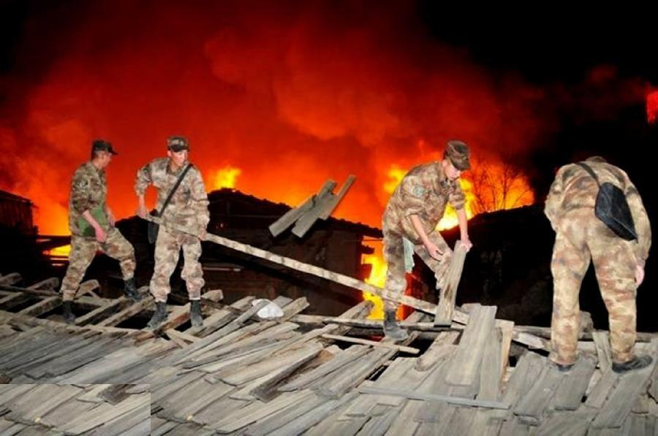
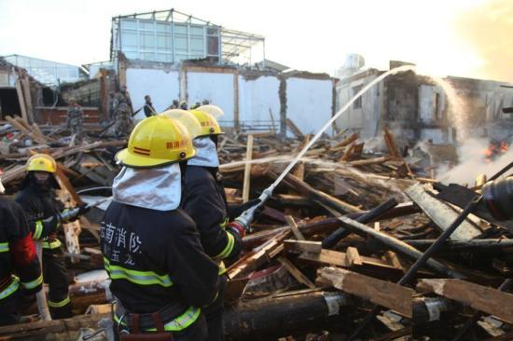
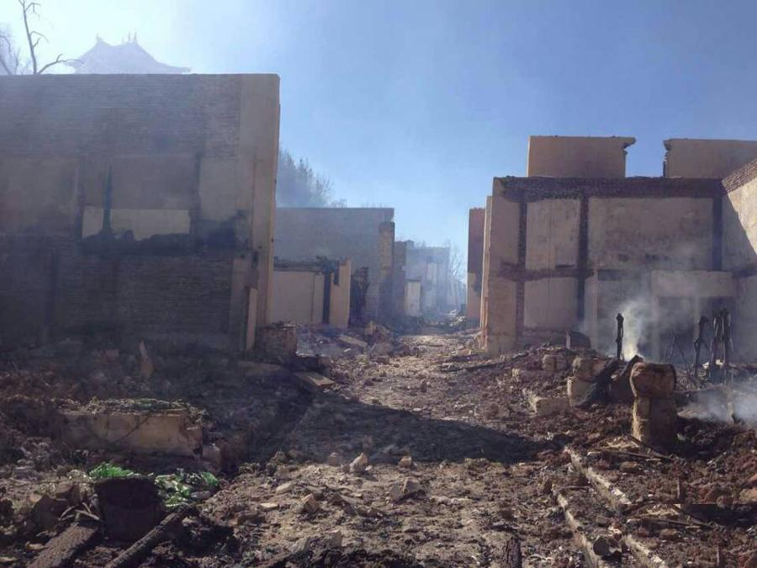
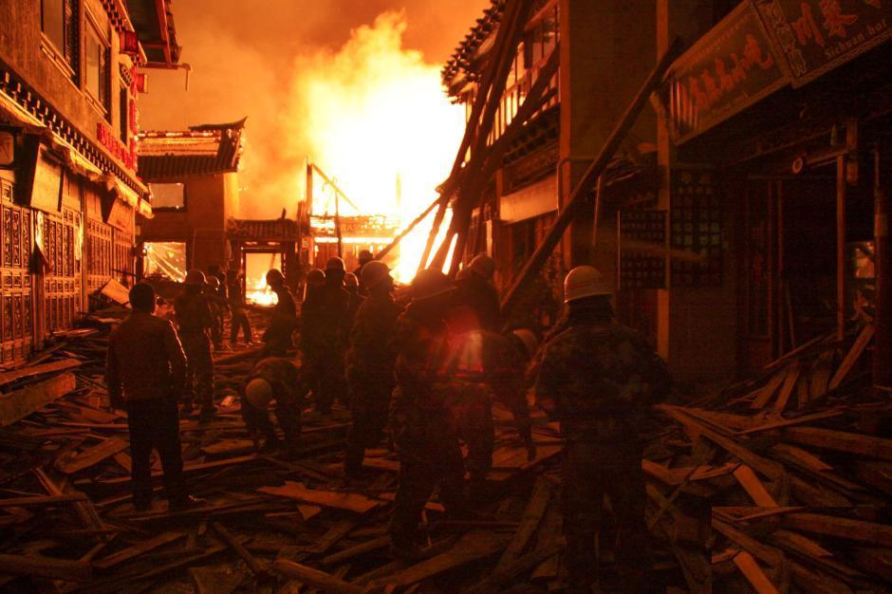
消防救灾
Fire Fighting

Slide 13
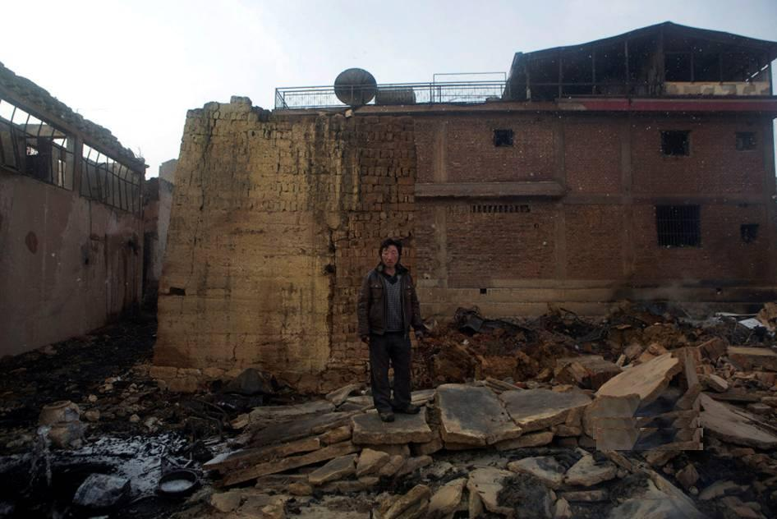
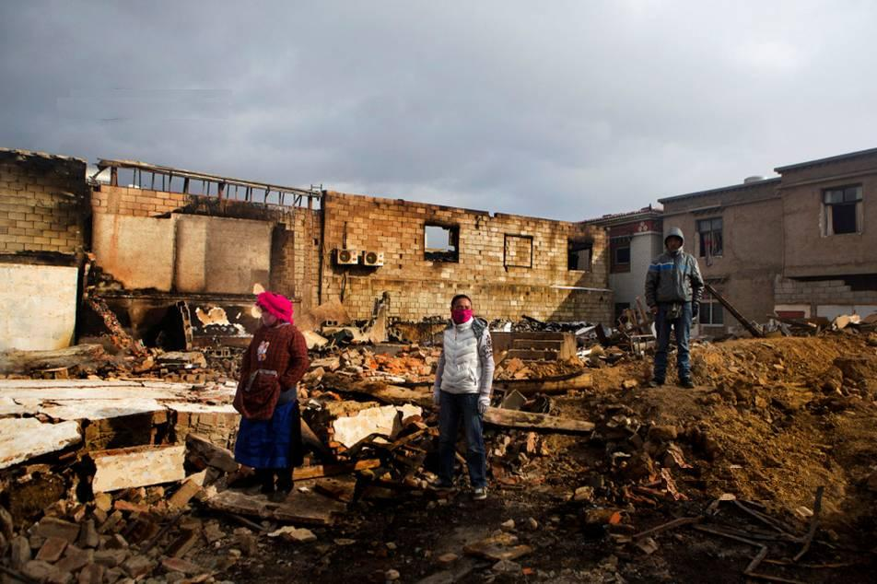
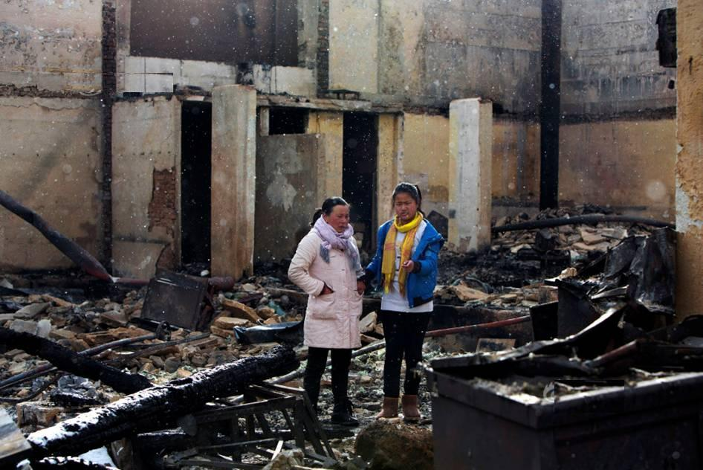
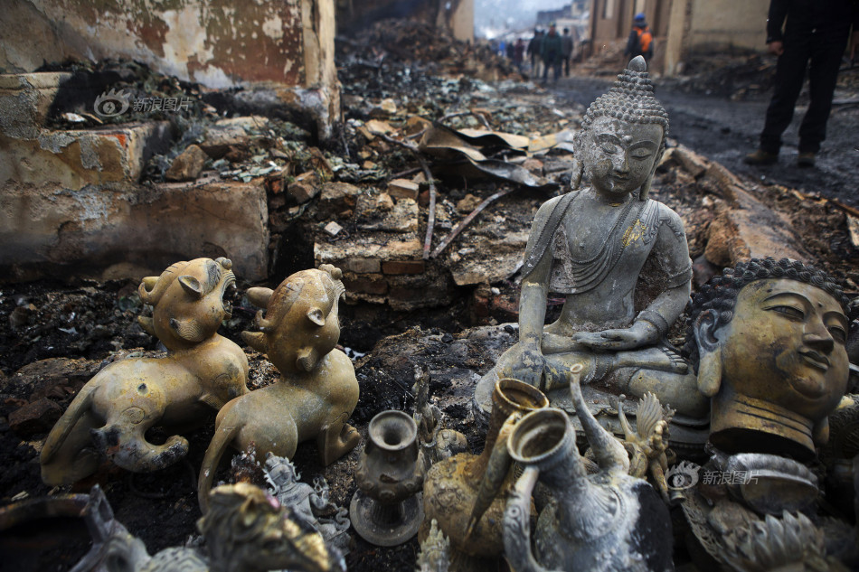
古城灾后
Ancient City Community after Fire

Slide 14
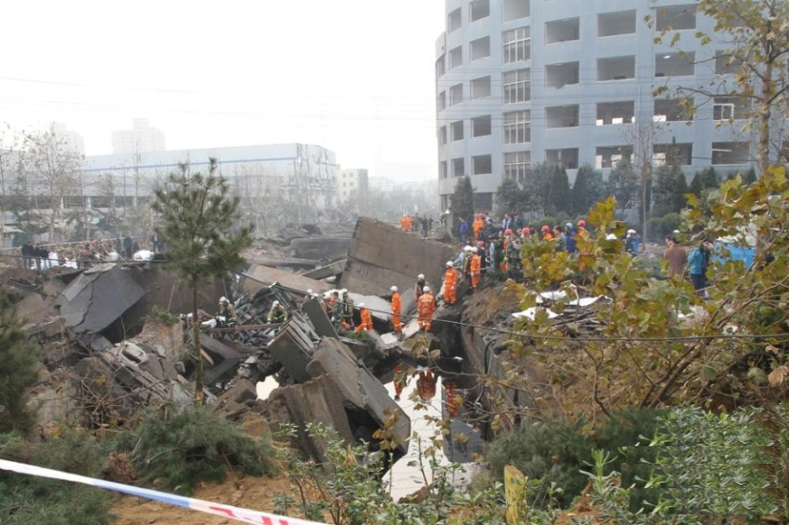
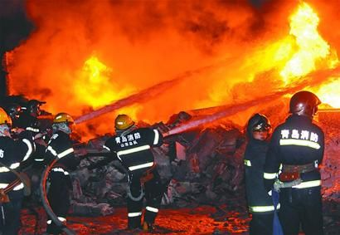
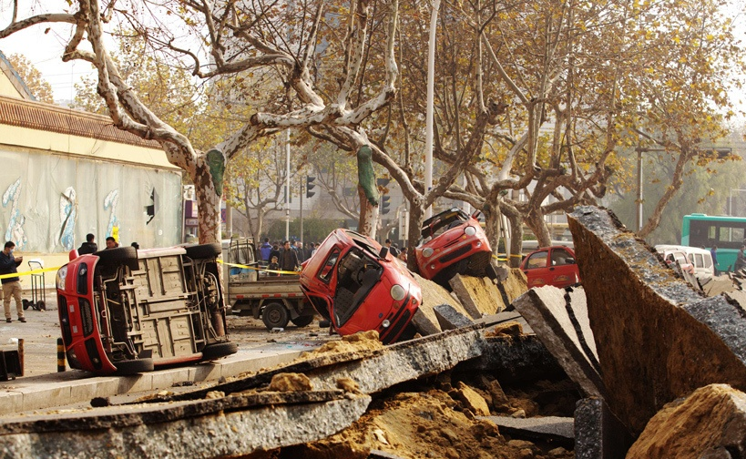
（b） 燃气管线火灾
Fire of Gas Pipeline
☆Qingdao gas pipeline Fire. The Sinopec oil pipeline leakage occurring in Qingdao of Shan Dong Province on November 22, 2013, leads to a terrible fire, 55 people has been killed, and 9 people missing, 136 people injured. The main reason of fire explosion accident is the urban unreasonable pipeline and drainage pipe network; poorly management of pipeline, resulting in oil leakage; the emergency disposal measures after leakage is undeserved, and set none alert area, blocking the roads and evacuating the people according to stipulations.

Slide 15
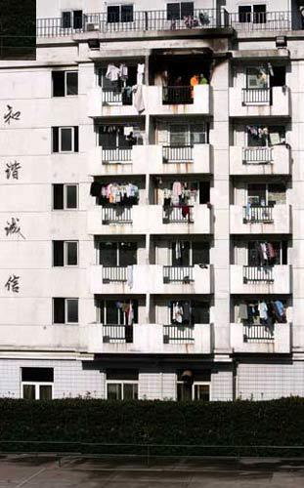
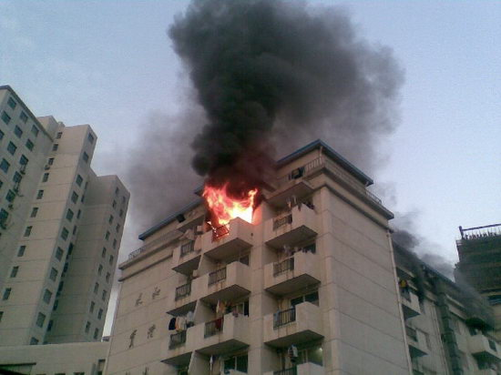
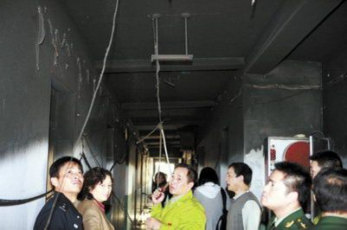
（c）学校宿舍火灾
Fire of dormitory
☆School dormitory fire. On November 16, 2008, a Shanghai Business School dormitory building has suffered a fierce fire, which was brought about by water heater, the fire ignite the sundry pile up on the lower bunk, 4 girls were killed and some people injured. In the fire, telescopic steel door cut off the escape way of the dormitory building, delaying the evacuation of students to safety area.

Slide 16
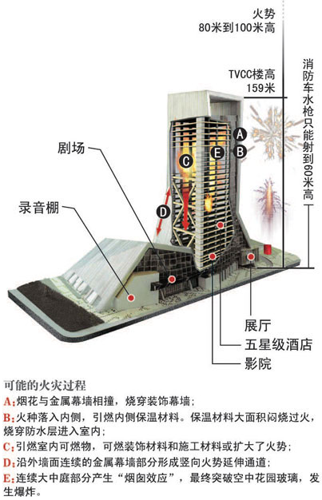
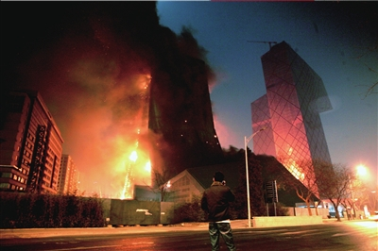
（d）高层火灾
Fire of High-rise Buildings
☆CCTV building fire. On February 9, 2009, CCTV new site building under construction located in Beijing ChaoYang District, suffering a fireworks fire with the cultural central building, 1 firefighter is sacrificed, six firefighters and two workers were injured. The damaged building area of 21333 m2, building layer of atrium has collapsed, causing a direct economic loss of 163.83 million yuan.

Slide 17
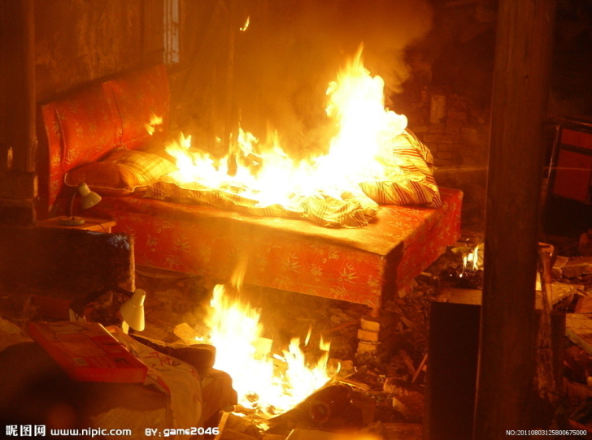
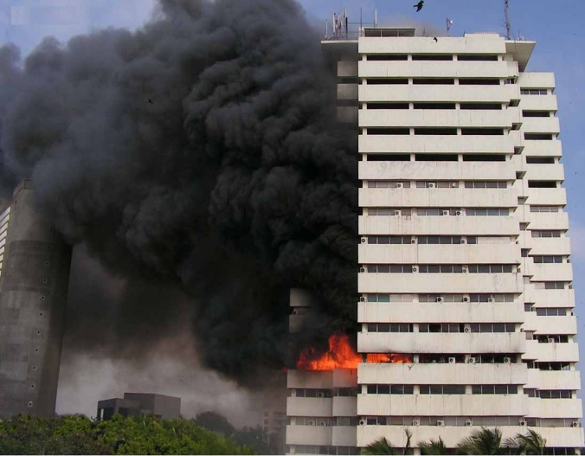
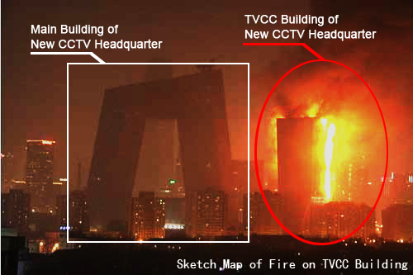
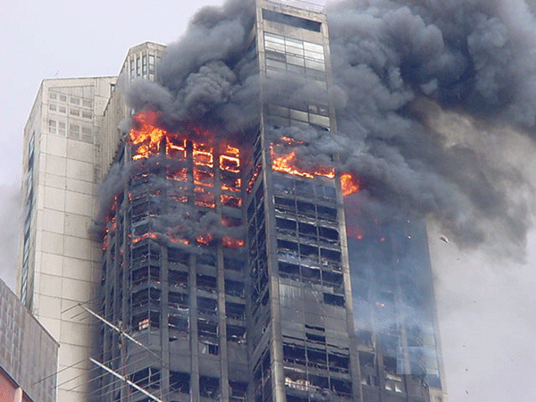
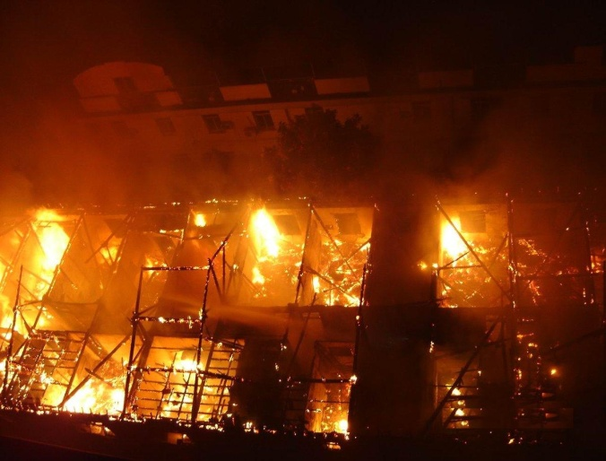
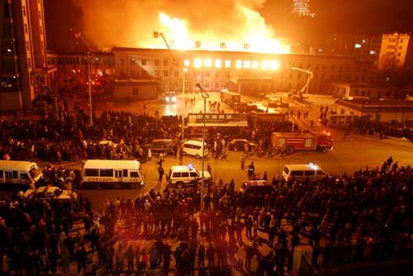
（3）灾害的进化新特点
New Characteristics of Disaster Evolution
In China, fire occur every 20 minutes, mainly in the high electric power consuming season of summer and winter. Community is the basic composition unit of the city, at the same time, the community is also the main part in the fight against disasters and responding to emergencies. The expression of community in disaster prevention, avoid disaster, disaster relief and other aspects directly related to the ability of disaster prevention and mitigation capacity of the whole city. Community disaster prevention research, therefore, has important practical significance for the urban disaster prevention programming.

Slide 18
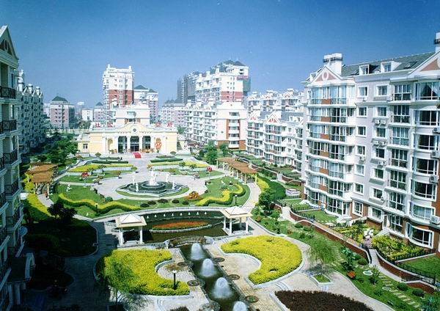
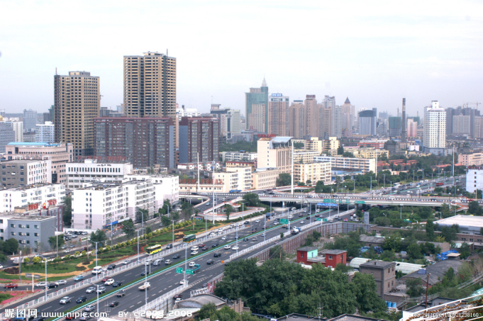

（3）灾害的进化新特点
New Characteristics of Disaster Evolution
community
city
New pattern characteristics
of urban structures,such as
subway and underground space
Disaster mitigation
become urgent
The evolution of disasters depend on lifeline engineering
Community as the basic unit of city
Strengthen community disaster prevention ability is benefit to the urban disaster mitigation

Slide 19
（3）灾害的进化新特点
New Characteristics of Disaster Evolution
Natural environment The status of risk,
Refuge facilities Evacuation path
Disaster prevention resource Improving building aseismic ability
Construction and improvement of the disaster prevention resource
→ community disaster prevention>>>>>finally improvement of the whole urban disaster prevention.
The main facing problems of the community disaster prevention

Slide 20
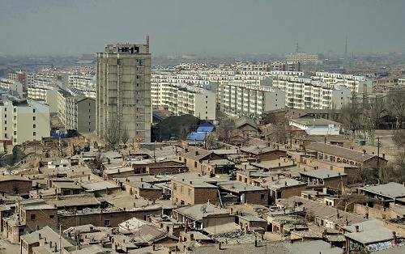
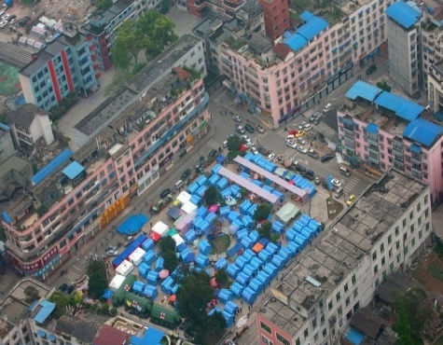
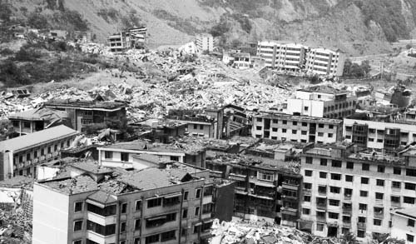
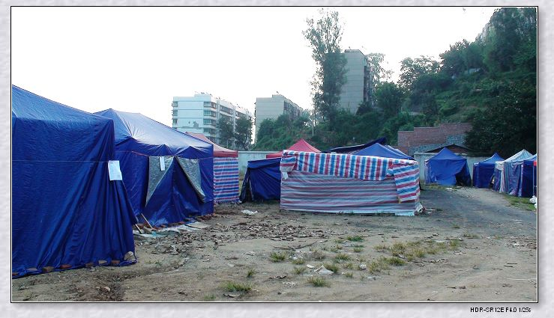
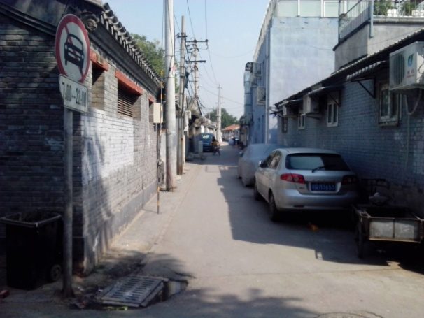
（3）灾害的进化新特点
New Characteristics of Disaster Evolution
At present, the measures for urban disaster prevention and mitigation are mainly through the city overall level. The construction of disaster prevention at the community level are closer to the residents’ actual demand, taking the community shelters as example, the refuge based on small squares and middle school campus in the city community can play an important role while emergency, which can make residents familiar with the geographical environment at ordinary times, with good cognitive and adaptability and easily reach shelters in time.
The old city area
Building vulnerability
Small square refugee community
Narrow road
Unsafe refuge

Slide 21
（4）减灾的有效措施
Effective Mitigation Measures
ConsciousPlan
Warning
Elements of disaster prevention
Improve infrastructure
Ensure of refuge facilities
(1) The urban infrastructure's ability to cope with earthquakes, floods and other disasters. The infrastructure construction should satisfy the demand of disaster prevention, risk avoiding, rescue effectively, meeting the requirements of disaster prevention level.
(2) Construction of risk avoiding system: a) ensure the exists of shelters, facilities and lifeline engineering b) the complete of disaster prevention information channels.
(3)The consciousness of disaster prevention, disaster prevention plan and plan effectively.

Slide 22

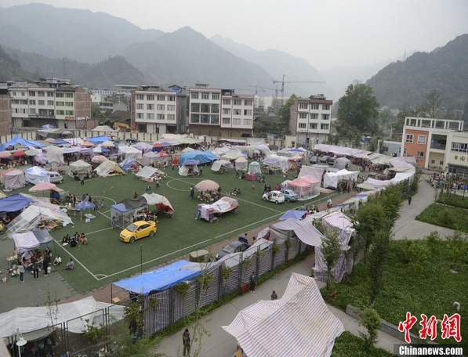
（4）减灾的有效措施
Effective Mitigation Measures
The Chinese government, explicitly proposed that the key defense targets of urban in construction of "world city" are waterlogging, earthquake, fire disaster and so on. In China, there are more than 136 cities located in 7 degrees and upwards of higher seismic fortification intensity area in China, more than 70% of the big cities and more than half of the population distribute in the area with meteorological disaster, ocean disaster, floods and earthquake severe natural disasters, so, earthquake, fire and flood are the main disaster-inducing factors as consideration for urban community. What is shown below is the refugee resettlement after Lushan earthquake.
Shelters of Lushan county
Shelters of Lushan high school

Slide 23
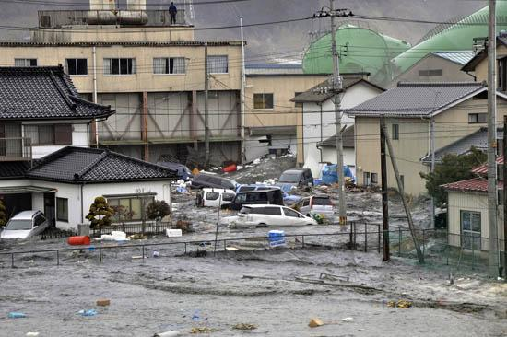
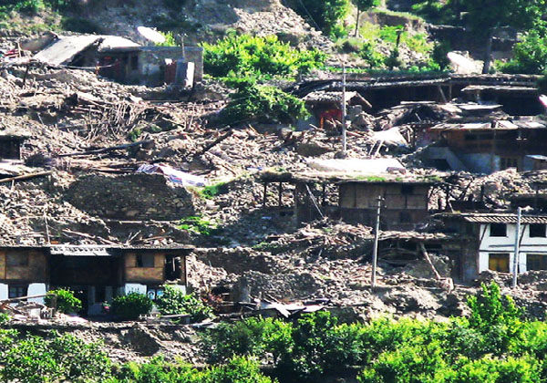
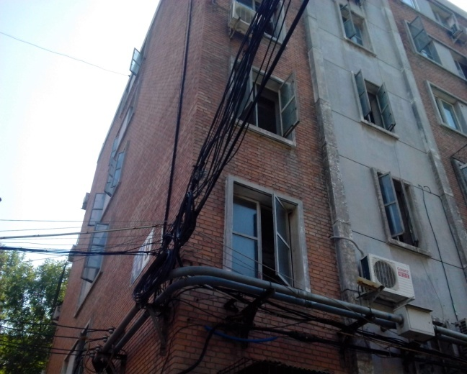
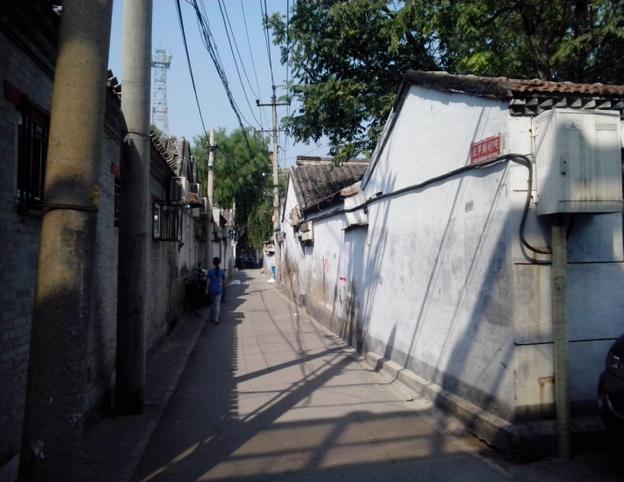
（5）面临的问题
Confronting Problem
（1） It is necessary to improve the seismic performance of buildings, especially the urban old community building with poorer seismic performance, strengthen the reconstruction of damaged housing in cities and towns and the urban shantytown is an important way to improve people's livelihood and accelerate the development of cities.
Japan 3.11 post-earthquake
5.12 Wen Chuan earthquake
A Beijing brick residential building
The some old hutongs of Beijing

Slide 24
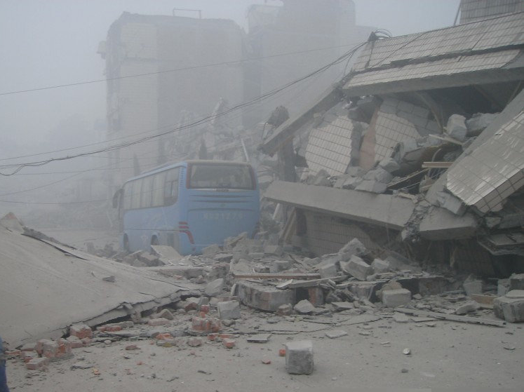



（5）面临的问题
Confronting Problem
（2）Under the effect of earthquake, the safety and connectivity of refugee road, fire fighting access, emergency road should be ensured in community.
Interruption of traffic congestion
Indirectly destruction because of the collapsed buildings
Interruption of traffic congestion in Kobe Earthquake
Direct destruction of road

Slide 25


（5）面临的问题
Confronting Problem
(3) The composition of urban community is complex, existing of different organization management mode, such as community neighborhood committees, property management committees, etc. It can be divided into residential community, school community, business community and so on from the community function types. In addition, due to the development planning of different periods, the old city communities, villages and shanty towns is also the weak links of urban development in recent years, there are 76 old communities and villages in Beijing Xi Cheng district as well as 138 old residential communities in Dong Cheng district, a brief account for 2/3.
Serious aging and defects of community buildings
Narrow entrance of lane

Slide 26
（5）面临的问题
Confronting Problem
(1)The innovation of disaster prevention community management system. At present Chinese city community is in accordance with the street area layout, urban community management responsibility is mainly undertaken by the community residents' committees. However the community residents' committees’ functions are badly in need of moving from singularity to plurality, cannot solve management problem on the disaster prevention and mitigation for community on many aspects. Residents' committees of some small scale community’ service function is not perfect, community cadres are so old that adapting to the needs of the community disaster prevention work under the new situation.
(2)The weak risk identification ability of community. There are much potential risk source in communities, residents’ recognition ability of risk source is insufficient, such as gas stations, chemical warehouse and so on, surrounding protection facilities is insufficient, without the community disaster prevention plan according with the actual situation
(3)Insufficiency of community disaster prevention resources. Disaster prevention resources and supporting materials for community planning emergency shelters is insufficient, as well as lack of effective management personnel.

Slide 27
（6） 主要的研究内容与研究意义
Main Research Contents and Research Significance
From urban communities composition and the disaster prevention of the external environment, focusing on the future of the city development needs, it is very important to study on community disaster evaluation method, set up a set of scientific and reasonable evaluation system of "disaster prevention community".

Slide 28

（6）主要的研究内容和研究意义
Main Research Contents
(1) Study on the current situation of typical community disaster prevention and the basic index system of disaster prevention;
(2) Research on the community disaster evaluation model and evaluation method;
(3) Research on the database construction method of disaster prevention community；
(4) The disaster prevention function evaluation and demonstration for different forms urban community.
Assessment process community disaster prevention capability

Slide 29
Main Content
1 研究背景
Research Background
2 社区防灾实地调查分析
Site Investigation on Urban Disaster Mitigation
3 防灾社区评价体系与指标
Evaluation System and Target of Urban Disaster Mitigation
4 模糊数学理论在社区防灾评价中的应用
Application of Fuzzy Mathematic Theory in the Evaluation on Urban Disaster Mitigation
5 体系评价方法与数据库建设
System Evaluation Method and Database Construction on Urban Disaster Mitigation

Slide 30



（1）防灾社区评价范围界定
Evaluation Scope of Disaster Prevention Community
Besides considering the population and land scale, division of disaster prevention community scope, also should be compatible with the city roads and natural geographical environment. Because of the different topography and physiognomy, many urban communities are surrounded by natural boundary conditions. On the definition of community wide, these boundaries become the natural boundaries.
Mountain
River
Reconstruction of Yingxiu
River
Mountain
Fireproof construction barriers
Japan Tokyo white beard area Park
District of Yantai city

Slide 31

（1）防灾社区评价范围界定
Evaluation Scope of Disaster Prevention Community
Therefore, the division of disaster prevention community based on the beneficial to the urban disaster mitigation function, disaster resource sharing, community disaster prevention management principles, the main city streets or evacuation road and the area surrounded by Urban natural boundaries (such as rivers, mountains, railway, etc.), the area can be composed of one or more community neighborhood committees, the division of the regional city size according to actual the distribution of evacuation routes and community size , the number of the resident population of about 20000, with the size of about 1 square kilometers in area.
secondary roads
Buildings, infrastructure, disaster prevention resources inside community
Emergency shelter
Main roads
Schematic diagram of the community evaluation scope

Slide 32

（1）防灾社区评价范围界定
Evaluation Scope of Disaster Prevention Community
Combined with China's specific functional scope of different levels of evacuation road , community as a basic unit of city fuses the evacuation routes, establish a regional disaster prevention stronghold which is composed of community school, cascade Park disaster prevention, and gradually expanded to the entire region. Built a point line surface disaster prevention system with Characteristics of circular and sustainable development.
Level division of our country's relief
evacuation passageway
道路级别 | 救灾干道 | 疏散主干道 | 疏散次干道
定义 | 在高于罕遇烈度的地震下需保障城市抗震救灾安全通行的道路，主要用于城市对内对外的救援运输，一般为连接外埠的快速路或高等级公路。 | 在大震下需保障城市抗震救灾安全通行的城市道路，主要用于连接城市中心或固定疏散场所、指挥中心和救灾机构或设施，一般为城市主干路。 | 在中震下能保障城市抗震救灾安全通行的城市道路，主要用于人员通往固定疏散场所，一般为城市主干路或次干路。
有效宽度要求 | 不小于15m | 不小于7m | 不小于4m
System of point, line and plane

Slide 33






（2） 社区调查
Field Survey of Disaster Prevention for Communities
Field survey is the the basic means to know the ability of disaster prevention and fire prevention of community, based on field investigation and analysis of five different communities from community basic characteristics, such as community population, population density, evacuation density, building net density, plot ratio, greening rate, outdoor waterproof area ratio, community facilities, drainage facilities, gas facilities, power facilities, site conditions, major hazards around, distance from major hazards resource, building vulnerability, risk of fire spread, completeness of fire fighting equipment..

Slide 34



（2）社区调查： 出入口与疏散道路
Exit and Emergency Roads
There are more entrances and exits in the old community, 16 inward and outward in Huguosi community , however only 7 motorways of which, the entrance of motorways are all open, the community roads appear very crowded once the motor vehicle entering into the community, most roads are one-way streets, vehicle collision avoidance is difficult.
Internal road conditions
Inlet and outlet
Narrow alleyway(width=2.7m)
Internal roads with electric box and parked cars

Slide 35




（2）社区调查：电力与排水
Power Facilities and Drainage
Power facilities within the community
Power facilities within the community
Drainage (less drain and residents dump water often)

Slide 36



（2） 消防出入口
Fire-fighting Access
The width of fire fighting access in communities along the Zhixin west road is only 3.35 meters, which did not meet the requirements of specification of 4.0 meters, and doors of channels are locked and closed by vehicles always. There are some problems with the design of fire fighting access, the entrances have been blocked by trees, people cannot go through.
Fire-fighting access1（3.35m）
Fire-fighting access2（3.30m）
Fire-fighting access 3
Fire-fighting access 4

Slide 37


（3） 社区调查：标识问题
The Problem of Sign System
An Zhen west community are built in1988 with 13 tower building, and 48 other buildings. The whole community has been divided into 4 part, details are the first part and second part are close to the Yuan Da Du park and the subway line 10, the third and fourth part are close to the 3 ring roads, the residential area greening rate by about 40%.
Out of the way of guidepost of fire-fighting signage
Refuges in the community park
Storage station of emergency supplies
Block of emergency exit

Slide 38
（4）社区调查：标识问题
The Problem of Sign System
According to the survey, some shopping malls near the communities present the evacuation chart of each layer, however, the position of charts should be improved, take the layer 1 as example, the the informational sign has been placed near the advertising board, it is easy for people to ignore the evacuation signs, and the advertising board are so big that the indication sign out of sight.
Evacuation diagram of floor 1
Evacuation diagram of floor 2
Block of Internal guide signs
Evacuation routes

Slide 39



防灾标识系统存在的问题
Existing Problems of Disaster Prevention Sign System
Where to go？
Billboard occupies a large number of sight
The influence of advertising on marking system
Part of the regional identity is missing
Identification is not uniform

Slide 40

图书馆类防灾标识调查实例分析
Survey Analysis of Library Disaster Prevention Signs
The main disaster characteristics of library facilities：
①Poor ventilation, drying and other reasons, fire prone characteristics.
②Electrical equipment focus and fire hazards can not be ignored.
③Entrance and exit of is narrow, evacuation path is long, is not
conducive to the personnel evacuation.
④The use of non-combustible material, flame retardant materials
increase the hazard.
⑤Fuel is more, safe flight time is short .
⑥Evacuation is difficult in the stereo space structure.
The characteristics of library facilities：
①Layout and structure is complex
The settings of disaster identification is important to the security of library .
②High density of people and big flow
③Local environment is crowded, path length of
evacuation is long

Slide 41






图书馆防灾标识调查
Investigation of Library Disaster Prevention Signs
The lack of library
index map
Long and narrow corridor lacks
of suggestive identification
The stairs lacks of relational identification
The identity of the floor
is not clear
Outside the library is lack
of identification
Outside library lack of
refuge identification

Slide 42




作为避难场所设施的周边标识系统
Surrounding Sign System of Evacuation Shelter
University gymnasium is located in the middle of the whole campus and connected to the stadium, gymnasium and playground surrounding dormitories for students and teachers bring stadium is located in the west side of sports venues, can be used as a disaster personnel shelter when the accident occurred between the stadium and gymnasium has a broad square, can be used as a evacuation passageway into the stadium from gymnasium.
Beijing Science and Technology University Gymnasium
Surrounding environment of the stadium

Slide 43








标识系统存在的问题
Existing Problems of Sign System
The type and quantity of the identification setting is insufficient, especially the evacuation identification out of the venues is not perfect.
No evacuation signs in the corridor
The stadium lack of external identification system
Safety exit signs set too high
The audience channel identify should be added

Slide 44


避难场所标识不清会导致的问题
Shelter Sign is Unclear will Causes Problems
Shanghai expo planning land scope of 5.28 square kilometers, the Pudong section of 3.93 square kilometers, Puxi is 1.35 square kilometers. The meeting place were divided into ABCDE five zones.
Expo overview map
Crowd
（1）The park is large in scale, complex zoning
（2）Large flow of visitors, personnel demand diversity
Disaster prevention sign system

Slide 45





标识应具备的要求
Necessary Requirements of Sign
The sign should have：
Indicator sign interrupt
Exit？
Exit sign mistakes
Too much information
Signs are blocked by advertising

Slide 46


标识设计原则
Signs Design Principles
(1) Continuous sign system
Airport, subway stations as a transit hub building has large staff mobility. Therefore, to improve the service efficiency of large public buildings, and effective disaster and normal personnel guidance is the main goal of sign system setting. Outdoor signs should strengthen the continuity of setting.
Exit

Slide 47

标识设计原则
Signs Design Principles
(2)Sign should be recognized easy and direct-viewing
The influencing factors of sign easily recognized mainly includes ：Sign itself Surrounding environment .
For sign itself included sign's location, size and sign setting, sign's position, size should be accord with the requirement of people . Give full consideration to people's best viewing angle on the plane and vertical direction .
V: 标识与眼睛的距离 (m)
S: 标识的表观尺寸(minute)
MVA: 最佳视力
a: 能见度水平
L_{b}: 背景亮度(cd/m²)
C:两度对比度
D: 视距 (m)
H: 标识高度 (m)
h: 眼睛高度(m)
GL

Slide 48



基于信息连续性的标识设置方法提案
Sign Setting Method Based on the Information Continuity
Requirements of information continuity
Division by area ：dangerous zone transitional zone safety zone
The most important is the signs setting at the turning point on the evacuation route, the set direction should be same as the direction of the optimum escape route.

Slide 49



C 建筑外部设置的标识种类
Types of the Sign outside C Building
Number | Types of sign | Basic requirement
① | 避难场地指向标识 |  | 按《地震应急避难场所标志地方标准》（DB 11224- 2004）设定。应急避难场所标志应设置在地震应急避难场所内及附近的场所，标识应设置在地震应急避难场所关联的醒目位置。应急避难场所周边道路指示标志牌的下缘距地面的高度应按照《道路交通标志和标线》(GB 5768-1999)第十三章第七条中的规定。
② | 安全区标识 |  | 应用《工作场所和公共区域中安全标志的设计原则》(GB/T 2893.1-2004)和《安全标志及其使用导则》(GB 2894-2008)的要求设置安全区标识。
③ | 特殊危险标识 |  | 应用《安全色》(GB/T 2893)中适当安全标记标示疏散路线中的障碍物。
Shelter
Outdoor signs distribution
Outdoor shelter
Sign for shelter

Slide 50



防灾标识的功能要求
Function Requirements of Disaster Prevention Sign
Necessary function of disaster prevention signs
The disaster prevention sign in building’s passageway should been recognized in darkness and continuously lead to the exit. The disaster prevention sign in building’s passageway should has the protection and assistance function to a certain extent beside the two function mentioned above. For example, it should has fire fighting apparatus, emergency lighting and special crowd auxiliary equipment to assist people evacuate to safe area effectively.
Nightime effect

Slide 51
















防灾标识的拓展、衍生要求
Extending, Derivative Requirements of Disaster Prevention Signs
Different pictographic graphics
Flood guide signs
Flood warning signs
Flood evacuation warning signs
Sample of disaster prevention signs
Tsunami shelter sign
Tsunami shelter guide signs

Slide 52

其他防灾问题
Other Disaster Prevention Problems
Figure 4. Schematic diagram of independent guide

Slide 53
Main Content
1 研究背景
Research Background
2 社区防灾实地调查分析
Site Investigation on Urban Disaster Mitigation
3 防灾社区评价体系与指标
Evaluation System and Target of Urban Disaster Mitigation
4 模糊数学理论在社区防灾评价中的应用
Application of Fuzzy Mathematic Theory in the Evaluation on Urban Disaster Mitigation
5 体系评价方法与数据库建设
System Evaluation Method and Database Construction on Urban Disaster Mitigation

Slide 54
3 Evaluation System and Target of Urban Disaster Mitigation
（1）Establishment of Index System
According to the urban community statistics summary field investigation and related literature, the index system of disaster prevention community is divided into three first-level indicators---basic characteristic, inherent risk and disaster prevention resources , and further refined into 12 second class indexes and 28 third class indexes.
Community disaster prevention indexes system(1/2)
Total index | First grade assessment index | Second grade assessment index | Third grade assessment index
Capability of Community disaster prevention U | Basic features of community U₁ | Community population U₁₁ | Population density U₁₁₁
 |  |  | Evacuation density U₁₁₂
 |  | Community building U₁₂ | Net building density U₁₂₁
 |  |  | Floor area ratio U₁₂₂
 |  | Control of community land using U₁₃ | Community greening rate U₁₃₁
 |  |  | Outdoor drainage area ratio U₁₃₂
 |  | Community lifeline facilities U₁₄ | Completeness of drainage facilities U₁₄₁
 |  |  | Completeness of gas facilities U₁₄₂
 |  |  | Completeness of power facilities U₁₄₃
 | Community inherent risk U₂ | Site condition U₂₁ | Site environment U₂₁₁
 |  | Surrounding hazards U₂₂ | Distance of peripheral hazard U₂₂₁
 |  | Building vulnerabilityU₂₃ | Building structure U₂₃₁
 |  | Fire spread risk U₂₄ | Distribution of fire belt U₂₄₁
 |  |  | Completeness of fire equipment U₂₄₂

Slide 55
3 Evaluation System and Target of Urban Disaster Mitigation
（1）Establishment of Index System
Community disaster prevention indexes system(2/2)
Total index | First grade assessment index | Second grade assessment index | Third grade assessment index
Capability of Community disaster prevention U | Community disaster prevention resources U₃ | Shelter system U₃₁ | Difficulty rate of emergency evacuation U₃₁₁
 |  |  | Per capita effective refuge area U₃₁₂
 |  |  | Set of disaster-reduction sign U₃₁₃
 |  |  | Safety of the shelter U₃₁₄
 |  |  | Completeness of supporting facilities U₃₁₅
 |  | Evacuation road system U₃₂ | Risk rate of road congestion U₃₂₁
 |  |  | Quantity of passageway U₃₂₂
 |  |  | Barrier-free access settings U₃₂₃
 |  | Fire rescue system U₃₃ | Accessibility of fire-fighting U₃₃₂
 |  |  | Difficulty rate of fire activity U₃₃₁
 |  |  | Completeness of fire escape U₃₃₃
 |  | Medical aid system U₃₄ | Accessibility of health care U₃₄₁
 |  |  | Number of doctor U₃₄₂
 |  |  | Number of beds U₃₄₃

Slide 56
3 Evaluation System and Target of Urban Disaster Mitigation
（1）Establishment of Index System
Judgment matrix and weight
Overall performance | First-grade index (Weight) | Second-grade index (Weight) | Dinghao building |  |  |  | Xidan building
 |  |  | Very good | Good | General | Poor | Very good | Good | General | Poor
Comprehensive disaster prevention ability of large scale commercial building | Blocking facilities (0.320) | Fire-fighting equipment (0.309) | 0.625 | 0.375 | 0 | 0 | 0.25 | 0.375 | 0.375 | 0
 |  | Fire protection district (0.581) | 0.625 | 0.375 | 0 | 0 | 0.375 | 0.375 | 0.125 | 0.125
 |  | Ventilation (0.110) | 0.375 | 0.375 | 0.25 | 0 | 0.25 | 0.25 | 0.375 | 0.125
 | Evacuation facilities (0.557) | Guiding sign (0.103) | 0.5 | 0.375 | 0.125 | 0 | 0 | 0.125 | 0.25 | 0.625
 |  | Emergency exit(0.523) | 0.625 | 0.375 | 0 | 0 | 0.25 | 0.25 | 0.5 | 0
 |  | Escape Route (0.374) | 0.25 | 0.5 | 0.25 | 0 | 0.375 | 0.375 | 0.25 | 0
 | Outdoor shelter (0.123) | Evacuation distance (0.480) | 0.625 | 0.25 | 0.125 | 0 | 0.375 | 0.25 | 0.375 | 0
 |  | Shelter area (0.405) | 0.5 | 0.375 | 0.125 | 0 | 0 | 0 | 0.5 | 0.5
 |  | Supporting facilities (0.115) | 0 | 0.25 | 0.5 | 0.25 | 0 | 0.125 | 0.375 | 0.5

Slide 57
3 Evaluation System and Target of Urban Disaster Mitigation
（1）Establishment of Index System
Disaster prevention index system of large scale commercial building

Slide 58
3 Evaluation System and Target of Urban Disaster Mitigation
（2）Quantitative Analysis of Community Basic Characteristic Indexes
（1）Community Population
Evaluation threshold of population density
Type | Low-layer | Multi-layer | High-layer
limiting density （person/ hm² ） | 210～300 | 350～500 | 380～590
Evaluation threshold of evaluation population density
Evaluation population density （person/m²） | Less than1.0 | 1.0～1.5 | 1.5～4.0 | Greater4.0
Class divide | 8～10 | 6～8 | 4～6 | <4

Slide 59
3 Evaluation System and Target of Urban Disaster Mitigation
（2）Quantitative Analysis of Community Basic Characteristic Indexes
（2）Community Architecture
Community building density including transverse density and longitudinal density, using building net density and plot ratio respectively to reflect the quality of community disaster prevention space.
Threshold of building net density
Threshold of building plot ratio
Layers | Building climate level
 | I、II、VI、VII | III、V | IV
LOW | 35 | 40 | 43
Multi | 28 | 30 | 32
Mid-high | 25 | 28 | 30
High | 20 | 20 | 22
Layers | Building climate level
 | I、II、VI、VII | III、V | IV
LOW | 1.10 | 1.20 | 1.30
Multi | 1.70 | 1.80 | 1.90
Mid-high | 2.00 | 2.20 | 2.40
High | 3.50 | 3.50 | 3.50

Slide 60
3 Evaluation System and Target of Urban Disaster Mitigation
（2）Quantitative Analysis of Community Basic Characteristic Indexes
（3）Community lifeline engineering equipment
Evaluation of drainage facilities
Evaluation requires | Community draining well layout is reasonable along the road, no water after the rain |  | Community draining well layout is reasonable along the road, almost no water after the rain |  | Community draining well layout is unreasonable along the road, water is serious at some places after the rain | Community lack complete drainage system, rain water is serious
Evaluation score |  | 8～10 |  | 6～8 | 4～6 | <4
Fire protection spacing of the gas
stations in the community
Name | Important public building |  | Civil construction | Main road side | Minor road side
I level | 25 |  | 15 | 10 | 5
II level | 15 | 8 |  | 8 | 5

Slide 61
3 Evaluation System and Target of Urban Disaster Mitigation
（3）Community Inherent Risk Analysis
（1）Community site
Favorable areas | 稳定基岩、坚硬土、开阔、平坦、密实、均匀的中硬土等； Stable bedrock, hard soil, open, flat, dense and uniform middle hard earth;
General areas | 不属于有利、不利和危险的地段； Do not belong to the favorable, unfavorable and dangerous area;
Unfavorable areas | 存在软弱土、液化土、条状突出的山嘴，高耸孤立地山丘，非岩质的陡坡、河岸和边坡的边缘，平面分布上成因、岩性、状态明显不均匀的土层（含故河道、疏松的断层破碎带、暗埋唐浜沟谷和半填半挖地基），高含水量可塑黄土，地表存在结构性裂缝；
Dangerous areas | 地震时可能发生滑坡、崩塌、地陷、地裂、泥石流等及地震断裂带上可能发生地表位错的部位； Landslide, collapse, subsidence, ground crack, mud-rock flow, surface dislocation may be happen when the earthquake occurs;

Slide 62
3 Evaluation System and Target of Urban Disaster Mitigation
（3）Community Inherent Risk Analysis
（2）Community surrounding hazards
Hazard refers to the potential energy and material release dangerous, can cause personnel injury, can be transformed into the accident in the role of triggering factors, area, location, space, position, equipment and its location, community risk sources include gas station, substation, storage, biochemical factory within the community and the surrounding.
Standard for urban planning on earthquake resistance and hazardous prevention （GB50413-2007）requires set up not less than 30 meters long fire-barrier belt between temporary emergency shelters and surrounding flammable buildings or other secondary fire source and not less than1000 meters away from the factory warehouse, gas plants, gas stations and other explosion hazard. Chinese scholar Gao Jie require that the distance between residential boundary and the recent secondary disaster source should be not less than the small secondary disaster of 150 ~ 200 meters, 300 ~ 400 meters away from the middle disaster source, 500 meters away from large secondary disaster source, and shall comply with the relevant requirements of fire safety standards, the fire safety belts of temporary shelter should be not less than 10 ~ 15 meters.

Slide 63
3 Evaluation System and Target of Urban Disaster Mitigation
（3）Community Inherent Risk Analysis
（3）Community building vulnerability
The seismic behavior of community building is the first protection line for community residents when the earthquake occurs, which is the most important line of defense, all the casualties caused by buildings collapsed or were damaged in the earthquake accounted for about 90% of the proportion of the casualties, the seismic behavior indexes mainly includes the following aspects: structure , construction time, fortification intensity, site condition, structure layers, using function, special structure, large span or towering non bearing decorative structure , ect .

Slide 64
3 Evaluation System and Target of Urban Disaster Mitigation
（3）Community Inherent Risk Analysis
（4）Risk of community fire spreading
Community fire spread risk mainly includes the distribution of fire fighting belt and the completeness of fire fighting equipment .The fire fighting belt means to prevent large area of fire spread, such as road, fireproof construction and fire prevention forest, etc. The completeness of fire fighting equipment mainly includes fire equipment within the community buildings, the number of fire hydrant, fire water tank and high spray and other fire fighting equipment at the around large public building.
Code for urban fire protection requires that municipal fire hydrant should be set up along the street and the road closed to the intersection , spacing should be not more than 120 meters, when the road width is more than 60 meters, it would be better to set up on both sides of the road, and the distance should not be more than 2 meters away from the side of the road and more than 5 meters away from the building's exterior wall .
Area constructing requirement of spreading prevention of fire
Grade | Win-width（m） | setting conditions
1 | 40 | 防止特大规模次生火灾蔓延，需保护建设用地规模7-12km²
2 | 28 | 防止重大规模次生灾害蔓延，需保护建设用地规模4-7km²
3 | 14 | 一般街区分割

Slide 65
3 Evaluation System and Target of Urban Disaster Mitigation
（4） Analysis of Community Disaster Prevention Resources
（1）Community shelter system
Accessibility of emergency shelter:《城市抗震防灾规划标准》（GB50413-2007）中规定紧急避难场所服务半径为500米，步行约5～10min之内可以到达。
Per capita refuge area ：《城市抗震防灾规划标准》中规定服务于社区级别的紧急避震疏散场所人均有效避难面积不小于1.0 m² 。
Settings of the disaster prevention sign ：社区防灾标识设置指社区范围内相关消防标识设置、前往避难场所的避难引导标识以及其他防灾标识应具有较好的连续性、有效性和系统性。
Security refuge shelter：服务于社区的中小型避难场所至少有两个不同方向的出入口，且为方便民众避难速率和救援车辆的进出，与出口邻接的道路不应小于8m，场所外围道路有效宽度不少于4m。
Complete supporting infrastructure ：主要包括：救灾帐篷、简易活动房屋，医疗救护和卫生防疫设施，应急供水设施，应急供电设施，应急排污设施，应急厕所，应急垃圾储运设施，应急通道，应急标志等设施。

Slide 66
3 Evaluation System and Target of Urban Disaster Mitigation
（4） Analysis of Community Disaster Prevention Resources
（2）Community evacuation routes system
Congestion risk degree of evacuation routes ：疏散道路阻塞危险度主要是指灾害作用下社区外围道路被阻塞的危险程度，主要利用高宽比来衡量其危险度，高宽比主要是指建筑物高度与道路总宽度之比。
The number of entrance：对社区出入口数量的评价，社区内至少存在两个不同方向的机动车出入口，社区出入口数量越多，社区与外界的通达性更好。
Barrier-free access Settings ：社区无障碍通道设置主要包括建筑出入口无障碍设置、道路缘石坡道设置和盲道设置、社区避难场所入口无障碍设置。

Slide 67
3 Evaluation System and Target of Urban Disaster Mitigation
（4） Analysis of Community Disaster Prevention Resources
（3）Community fire rescue system
Accessibility of firefighting ：我国《城市消防规划规范》中规定城市规划区内普通消防站的规划布局，一般情况下应以消防队接到出动指令后正常行车速度下5分钟内可以到达其辖区边缘为原则确定，其辖区面积不应大于15km²
Difficult rate of regional firefighting ：区域消防活动困难率是指社区内消防活动难以到达的区域面积占社区总面积的比值。其与社区消防栓的部分，消防通道的分布有关。
Complete extent of the fire escape ：我国《建筑设计防火规范》（GB50016-2006）要求街区内道路考虑消防车的通行，道路中心线间距不宜超过160m，当建筑物的沿街部分长度超过150m或总长度超过220m时宜设置穿过建筑物的消防车通道；消防车通道净宽度和净空高度均不应低于4m，与建筑外墙宜大于5m ；石油化工区的生产工艺装置、储罐区等处的消防车通道宽度不应小于6m，路面上净空高度不应低于5m，路面内缘转弯半径不宜小于12m；

Slide 68

（4）社区防灾资源分析：社区标识设置的合理性
Analysis of Community Disaster Prevention Resources: the Rationality of Community Sign settings
According to the disaster prevention signs cognitive zoning method ,the community is divided into three parts--risk, security, transition region, the community region division and guide sign settings of dangerous zone are as shown in the picture. The focus of the disaster prevention signs are different in different areas.
Demonstration community region division and Guide sign settings of dangerous zone

Slide 69






（4）社区防灾资源分析：不同认知区域防灾标识设置
Analysis of Community Disaster Prevention Resources: Disaster prevention
Sign settings of Different Area
The intersection of the T-junction, demonstration community resident's escape direction is the main road from east to west, the guide signs should indicate the integer distance, the interval can be 50m or 100m .
There is a crossroads at the exit of 7 residential building, south west of the road can be used as an optional security route, considering human's visual angle, the evacuation signs should be set up to 45 °angle .
There are some other buildings at the front of the 2 residential buildings, north and south road can go to the disaster prevention park , so we need to set some signs point to the two directions in front of the exit.

Slide 70


（4）社区防灾资源分析：不同认知区域防灾标识设置
Analysis of Community Disaster Prevention Resources: Disaster prevention
Sign settings of Different Area
We can use more comprehensive disaster prevention signs at some important traffic intersection within 3 km distance from disaster prevention parks, signs are fixed on the floor, the size of signs and text graphics size as shown in picture.

Slide 71


（4）社区防灾资源分析：避难场所防灾标识设置
Analysis of Community Disaster Prevention Resources: Refuge
Shelter Sign Settings
Community refuge is a safe zone, as a safe haven, on the main roads inside the community should be set guidance signs. In the shelter should have emergency command post, lighting, emergency tent accommodation area, emergency drinking water, emergency toilet, emergency supplies supply station and emergency medical aid station sign.
Emergency treatment sign
Emergency tent accommodation area sign

Slide 72
Main Content
1 研究背景
Research Background
2 社区防灾实地调查分析
Site Investigation on Urban Disaster Mitigation
3 防灾社区评价体系与指标
Evaluation System and Target of Urban Disaster Mitigation
4 模糊数学理论在社区防灾评价中的应用
Application of Fuzzy Mathematic Theory in the Evaluation on Urban Disaster Mitigation
5 体系评价方法与数据库建设
System Evaluation Method and Database Construction on Urban Disaster Mitigation

Slide 73
4 Application of Fuzzy Mathematic Theory in the Evaluation on Urban Disaster Mitigation
Design of Comprehensive Evaluation Method for Disaster Prevention Community
Comprehensive assessment is the objective, impartial, reasonable evaluation of objects. Disaster prevention for community comprehensive evaluation is mainly composed of five elements, namely, evaluation object, evaluation index, weight coefficient, fuzzy model and evaluators. Ultimate goal of the research is to build a comprehensive evaluation model of community disaster prevention, the following type:
is on behalf of index weight vector
is on behalf of index condition vector
The sketch map of comprehensive assessment

Slide 74
4 Application of Fuzzy Mathematic Theory in the Evaluation on Urban Disaster Mitigation
Rearch on the Weight of Index System
The most important link of analytic hierarchy process (AHP) is to construct the judgment matrix, the experts classified and judged according to the judgment language, traditional 1-9 scale language in the following table:
1～9 scaling method
Value | 1 | 2 | 3 | 4 | 5 | 6 | 7 | 8 | 9
meaning | 同样 重要 | 微小 重要 | 稍微 重要 | 更为 重要 | 明显 重要 | 十分 重要 | 强烈 重要 | 更强烈 重要 | 极端 重要
The traditional 1~9 scaling method, some word like "highly important", "extremely important" and so on are so vague, the person who judge are often difficult to accurately grasp the actual situation, which will lead poor consistency and superabundant iterations, low efficiency, slow convergence and so on.
Construction process of traditional judgment matrix

Slide 75
4 Application of Fuzzy Mathematic Theory in the Evaluation on Urban Disaster Mitigation
Mathematical Methods - hierarchical Fuzzy Optimization Theory
Hierarchical fuzzy optimization theory is a specific application of the fuzzy mathematics method, the basic idea of which is gatherring the maximum of evaluation factors in the index system as the best community, and gatherring the minimum of evaluation factors in the index system as the worst community, the two communities don't exist actually. Then, calculating the distance (norm namely) between certain community with the two ideal community, then rankking the data as well as the assessment value of communities.
Suppose that the number of communities to be evaluated is n, and for each community there are m factors, and give the quantitative value x to each factor, the eigenvector can be established of each factor.
The value of evaluation factor is set as Xij, i is on behalf of the evaluation factors i, j on behalf of the evaluation community j, the evaluation matrix of community (num=n) as follows:

Slide 76
4 Application of Fuzzy Mathematic Theory in the Evaluation on Urban Disaster Mitigation
Mathematical Methods - hierarchical Fuzzy Optimization Theory
Evaluation factors eigenvalues in matrix X can be converted to the corresponding degree of membership, namely the percentage of a certain evaluation factor value in the summation of maximum and minimum value of all evaluation factor value. The conversion formula is as follows:
To the evaluation factors that the bigger is the better type, the transformation is as following:
To the evaluation factors that the smaller is the better type, the transformation is as following:
h represents the line h. degree of membership matrix R can be obtained as following:
Take the maximum of line in the degree of membership matrix getting the optimal value of each evaluation index, as well as the optimal eigenvalue vector for community evaluation.

Slide 77
4 Application of Fuzzy Mathematic Theory in the Evaluation on Urban Disaster Mitigation
Mathematical Methods - hierarchical Fuzzy Optimization Theory
Similarly, take the minimum of line in the degree of membership matrix getting the optimal value of each evaluation index, as well as the optimal eigenvalue vector for community evaluation.
Using the method mentioned above to determine the each index weights for community evaluation, the weight vector can be concluded.
Based on the membership degree matrix and optimal or worst feature vector calculated above, confirm the weighting distance between each index factor and the ideal value and the least ideal value. As to the optimal feature vector, the weighted distance vector as follows:
Similarly, as to the worst feature vector, the weighted distance vector as follows:
Take the first-order norm of the vector as the distance between optimal value of whole index system and the value of communities
Similarly, as the distance between worst value of whole index system and the value of communities

Slide 78
4 Application of Fuzzy Mathematic Theory in the Evaluation on Urban Disaster Mitigation
Mathematical Methods - hierarchical Fuzzy Optimization Theory
The best situation is the lest weighting distance quadratic sum between the evaluation community and optimal index system, worst index system. The higher level of membership degree matrix is determined through the principle.
To make the weight distance quadratic sum minimized, the F(u1j) first-order countdown is 0, so calculate the derivation of F(u1j), getting the calculation method for calculating the membership degree matrix in higher level.
For the first-order norm, its calculation can be simplified as follows:
Similarly, for the worst system

Slide 79
4 Application of Fuzzy Mathematic Theory in the Evaluation on Urban Disaster Mitigation
Mathematical Methods - hierarchical Fuzzy Optimization Theory
Take the formula above, can get the comprehensive evaluation model as follows:

Slide 80
4 Application of Fuzzy Mathematic Theory in the Evaluation on Urban Disaster Mitigation
Establishment and Application of Comprehensive Evaluation Method
The score of second index for typical community
Index | BeiKeDa | Anzhen Xili | Huixin Beili | Erli Zhuang | Huguosi
Population | 6.245 | 9.03 | 7.37 | 6.64 | 3.54
Building | 8 | 9 | 7.5 | 6.75 | 6
Land controlling | 9 | 10 | 8 | 6.50 | 2
Lifeline facilities | 8.57 | 7.18 | 9 | 7.22 | 3.76
Site condition | 10 | 9 | 10 | 9 | 9
Major danger source Surrounding | 7 | 9 | 9 | 3 | 9
Buildings vulnerability | 8.2 | 6.2 | 9 | 5.24 | 2
The fire spread risk | 8 | 7.13 | 9.25 | 6.5 | 3
Shelter | 9.12 | 9.57 | 8.41 | 6.95 | 4.77
Emergency exit | 8.37 | 8.8 | 8.51 | 6.86 | 4.68
Fire rescue | 8.76 | 8.31 | 8.08 | 6.35 | 5.38
Medical aid | 7.67 | 8.45 | 8.25 | 7.25 | 8.50
Selecting the Beijing BeiKeDa community (including BeiKeDa campus), Anzhen Xili community , Huixin Beili community, Erli Zhuang community and Huguosi community 5 communities as the research objects, making evaluations from aspects of the index system established.

Slide 81

4 Application of Fuzzy Mathematic Theory in the Evaluation on Urban Disaster Mitigation
Establishment and Application of Comprehensive Evaluation Method
Each community has its different characteristics, using the radar map to describe the second index of five communities, from the saturation of shadow in the radar map can see the community comprehensive disaster prevention ability and the aspects which should be strengthened.
Transform the score of first index to hundred-mark system, the BeiKeDa community score of 84.2, the Anzhen Xili community score of 84, the Huixin Beili community score of 84.2, the Erli Zhuang community score of 64, the Huguosi community score of 50.2. The red part in the radar chart means the weak disaster prevention ability while the The yellow part in the radar chart means the medium disaster prevention ability, The green part in the radar chart means the good disaster prevention ability.

Slide 82
4 Application of Fuzzy Mathematic Theory in the Evaluation on Urban Disaster Mitigation
Establishment and Application of Comprehensive Evaluation Method

Slide 83
4 Application of Fuzzy Mathematic Theory in the Evaluation on Urban Disaster Mitigation
Establishment and Application of Comprehensive Evaluation Method
（3）Hierarchical Fuzzy optimization theory（Method 3）
Hierarchical fuzzy optimization theory is the application of fuzzy transformation theory and maximum membership degree principle, considering things related to various factors and draw the comprehensive evaluation. This method has following advantages: this method can transform the qualitative factor into quantitative factor, and deal with a large complex system effectively, can reflect the different levels of evaluation factors, as well as avoiding the drawback of difficult to assign weights because of the overmuch factors.
Construct characteristic matrix
X_{mn} for community evaluation
Transform evaluation factors into corresponding membership degree according to X
Construct membership degree matrix R_{mn}
Determine the higher level membership degree matrix
According to the membership degree matrix and optimal (worst) characteristic vector established before, calculate the weighted distance between each index factors and the ideal (worst) value .
Get the optimal, worst feature vector ,
Comprehensive assessment model
Index weight vector

Slide 84
4 Application of Fuzzy Mathematic Theory in the Evaluation on Urban Disaster Mitigation
Establishment and Application of Comprehensive Evaluation Method
As can be seen from the comprehensive evaluation score, Huixin Beili community as seismic safety demonstration community get high score in various aspects, the follwing are Bei Ke Da community , Anzhen Xili community, Er Li Zhuang community and Hu Guo Si community. We can classify the assessment levels of disaster prevention community, and dividing the communities into "excellent, good, general, unqualified" four level as shown in the following table according to the different rating score.
Grading of disaster prevention community
Grading | Excellent | Good | General | Disqualification
Score | Above 85 | 75-85 | 60-75 | Below 60
Measures | Continue to maintain | Strengthen partly | Strengthen comprehensive | Rectify and reform
According to the evaluation result, the disaster prevention situation of Huixin Beili community should be kept, BeiKeDa community and Anzhen Xili community should be partly, Erli Zhuang community should be strengthened all sidedly, the Hu Guo Si community should be rectified and reformed as soon as possible.

Slide 85
4 Application of Fuzzy Mathematic Theory in the Evaluation on Urban Disaster Mitigation
Comparison of Different Methods
The comprehensive evaluation result vectors of 5 communities using multi-level fuzzy evaluation method is U=[0.9307 0.3971 0.1081 0.9550 0.8549], the order of the 5 communities disaster prevention ability from strong to weak are as follows:
Huixin Beili community(0.9550)
Bei Ke Da community(0.9307)
Anzhen Xili community(0.8549)
Erli Zhuang community(0.3971)
Huguo Si community(0.1081
We can see that the results under single layer fuzzy optimization method is the same as that under fuzzy comprehensive evaluation method, but the conclusion are more discrete, the hierarchical fuzzy evaluation method overcome the disadvantages that the conclusion of fuzzy comprehensive evaluation model tend to be homogenization, and is difficult to produce reasonable evaluation results.

Slide 86
Main Content
1 研究背景
Research Background
2 社区防灾实地调查分析
Site Investigation on Urban Disaster Mitigation
3 防灾社区评价体系与指标
Evaluation System and Target of Urban Disaster Mitigation
4 模糊数学理论在社区防灾评价中的应用
Application of Fuzzy Mathematic Theory in the Evaluation on Urban Disaster Mitigation
5 体系评价方法与数据库建设
System Evaluation Method and Database Construction on Urban Disaster Mitigation

Slide 87

5 System Evaluation Method and Database Construction on Urban Disaster Mitigation
GUI Program Implementation of Comprehensive Evaluation Method
According to the established index system under quantitative methods and comprehensive evaluation model, including each quantitative factor, using Matlab to establish convenient graphical interface (GUI) with a simple program to conduct calculation.
The preliminary establishment of calculation program

Slide 88


5 System Evaluation Method and Database Construction on Urban Disaster Mitigation
Output Project Selection and Results Output
Calculation conditions
Building damage rate
Calculation of block probability under different situation
——Hiking, stretcher, small cars, fire engines
Low
High
Arrival rate of fire facilities
Difficulty value of fire fighting
Low
High
Blocking rate of roads
Blocking rate of buildings
Low
High

Slide 89
5 System Evaluation Method and Database Construction on Urban Disaster Mitigation
Database Software Evaluation and Measures
Level | Level description | Level of security | Preconceive damage situation | Measures
A | substandard | With serious problems, cannot meet the basic requirements | House damaged seriously, cause casualties, it’s difficult to restore the community | Conduct a detailed and all-sided investigation and evaluation of the current situation for community, and take targeted measures according to the results of the evaluation.
B | standard | With some problems, achieve the basic requirements | House damaged seriously, without casualties, the community can be restored in a certain time. | Conduct a targeted investigation and evaluation of the current situation for community, and take effective measures according to the results of the evaluation.
C | standard completely | comply with the requirements of community disaster prevention completely | House damaged lightly, without casualties, the community can be restored in a short time. | strengthen and cultivate the residents awareness of disaster prevention

Slide 90

5 System Evaluation Method and Database Construction on Urban Disaster Mitigation
Comparison of Different Evaluation Indexes among 5 Communities

Slide 91

5 System Evaluation Method and Database Construction on Urban Disaster Mitigation
Comparison of Different Factors for the Same Community

Slide 92
Thank you for your attentions！
Song Bo
Professor
University of Science and Technology Beijing
Civil and Environmental Engineering School, Department of civil engineering
Committee member of seismic prevention and disaster mitigation technology of Chinese civil engineering society
Committee member of Soil dynamics committee of vibration engineering society
Committee member of Chinese urban seismic prevention and disaster mitigation review committee
Committee member of anti-collapse committee of architectural society of China
（songbo@ces.ustb.edu.cn）
13366236292 010-62334929

